Slide 1

Equation of States of Nuclear Matter and Tidal deformation of Neutron Stars
by
Nguyen Hoang Dang Khoa
Supervisors:
Prof. Dao Tien Khoa Dr. Ngo Hai Tan

Slide 2
Table of Contents
Introduction:
What is a Neutron Star?
Nuclear Matter and Neutron Star?
Spin polarization effect
Tidal deformation in a binary neutron star system
Calculation methods:
β-stable nuclear matter
Neutron Star’s magnetic properties
Tolman-Oppenheimer-Volkoff equation
Tidal Love numbers
Results and Discussions
Conclusions

Slide 3


Introduction What is a Neutron Star?
●○○○○

Slide 4

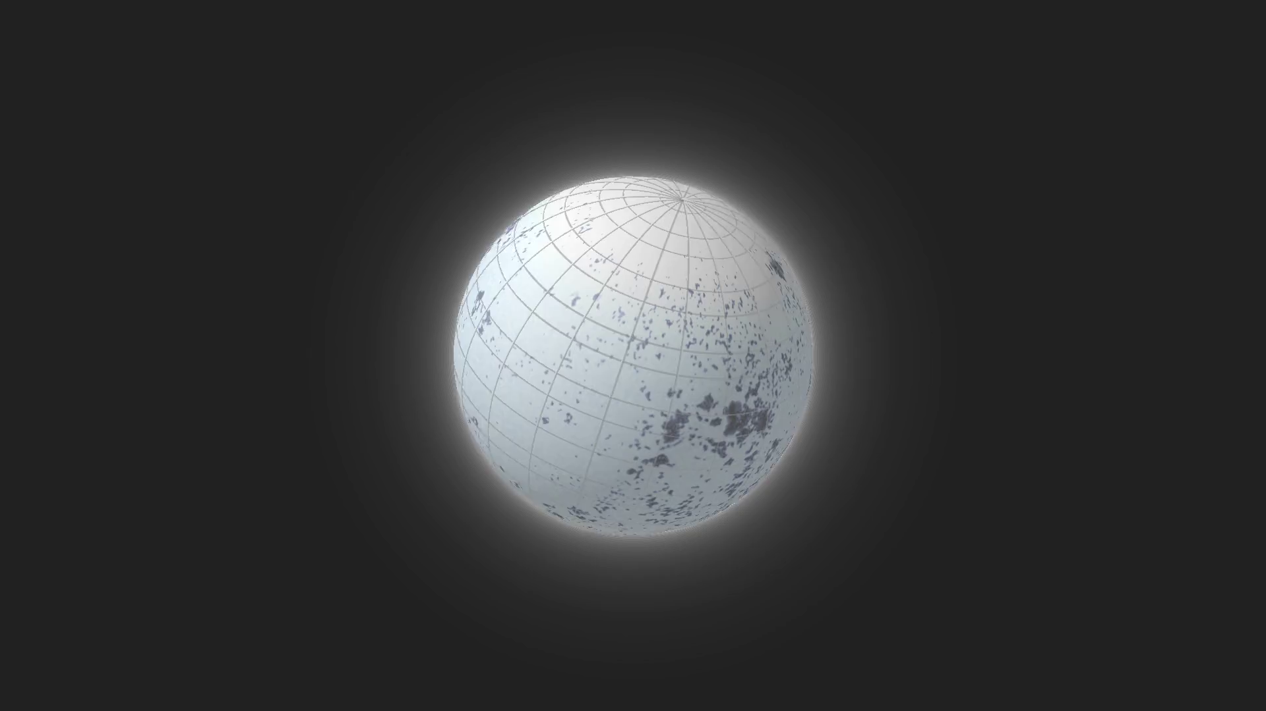
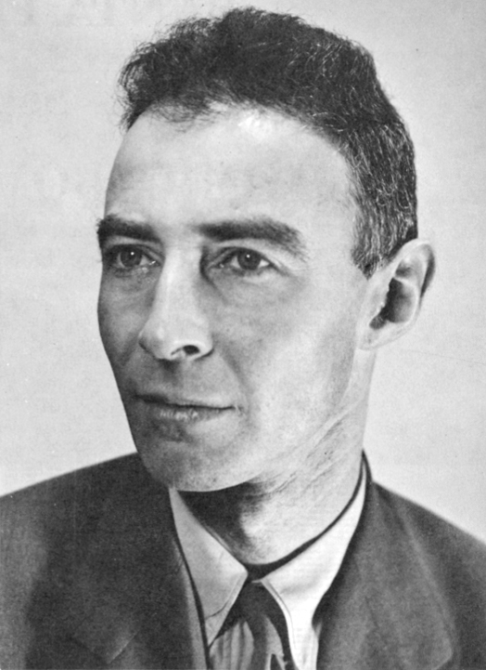
Introduction Nuclear Matter and Neutron Star?
○●○○○
1939
TOV equation

Slide 5
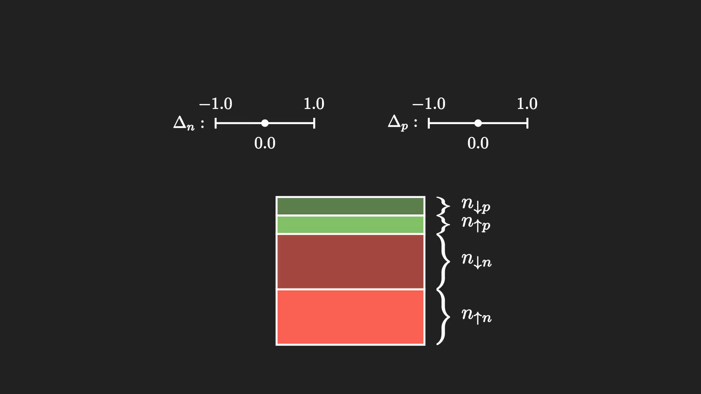
Introduction Spin polarization effect
○○●○○

Slide 6
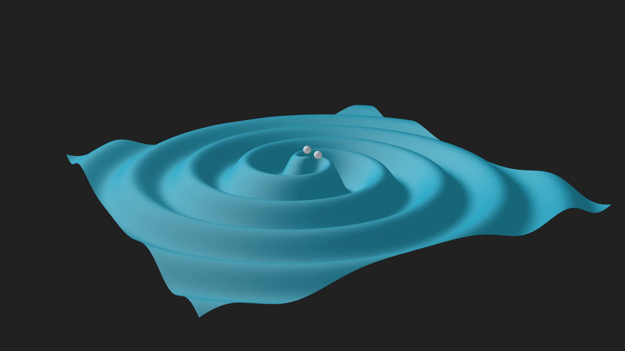
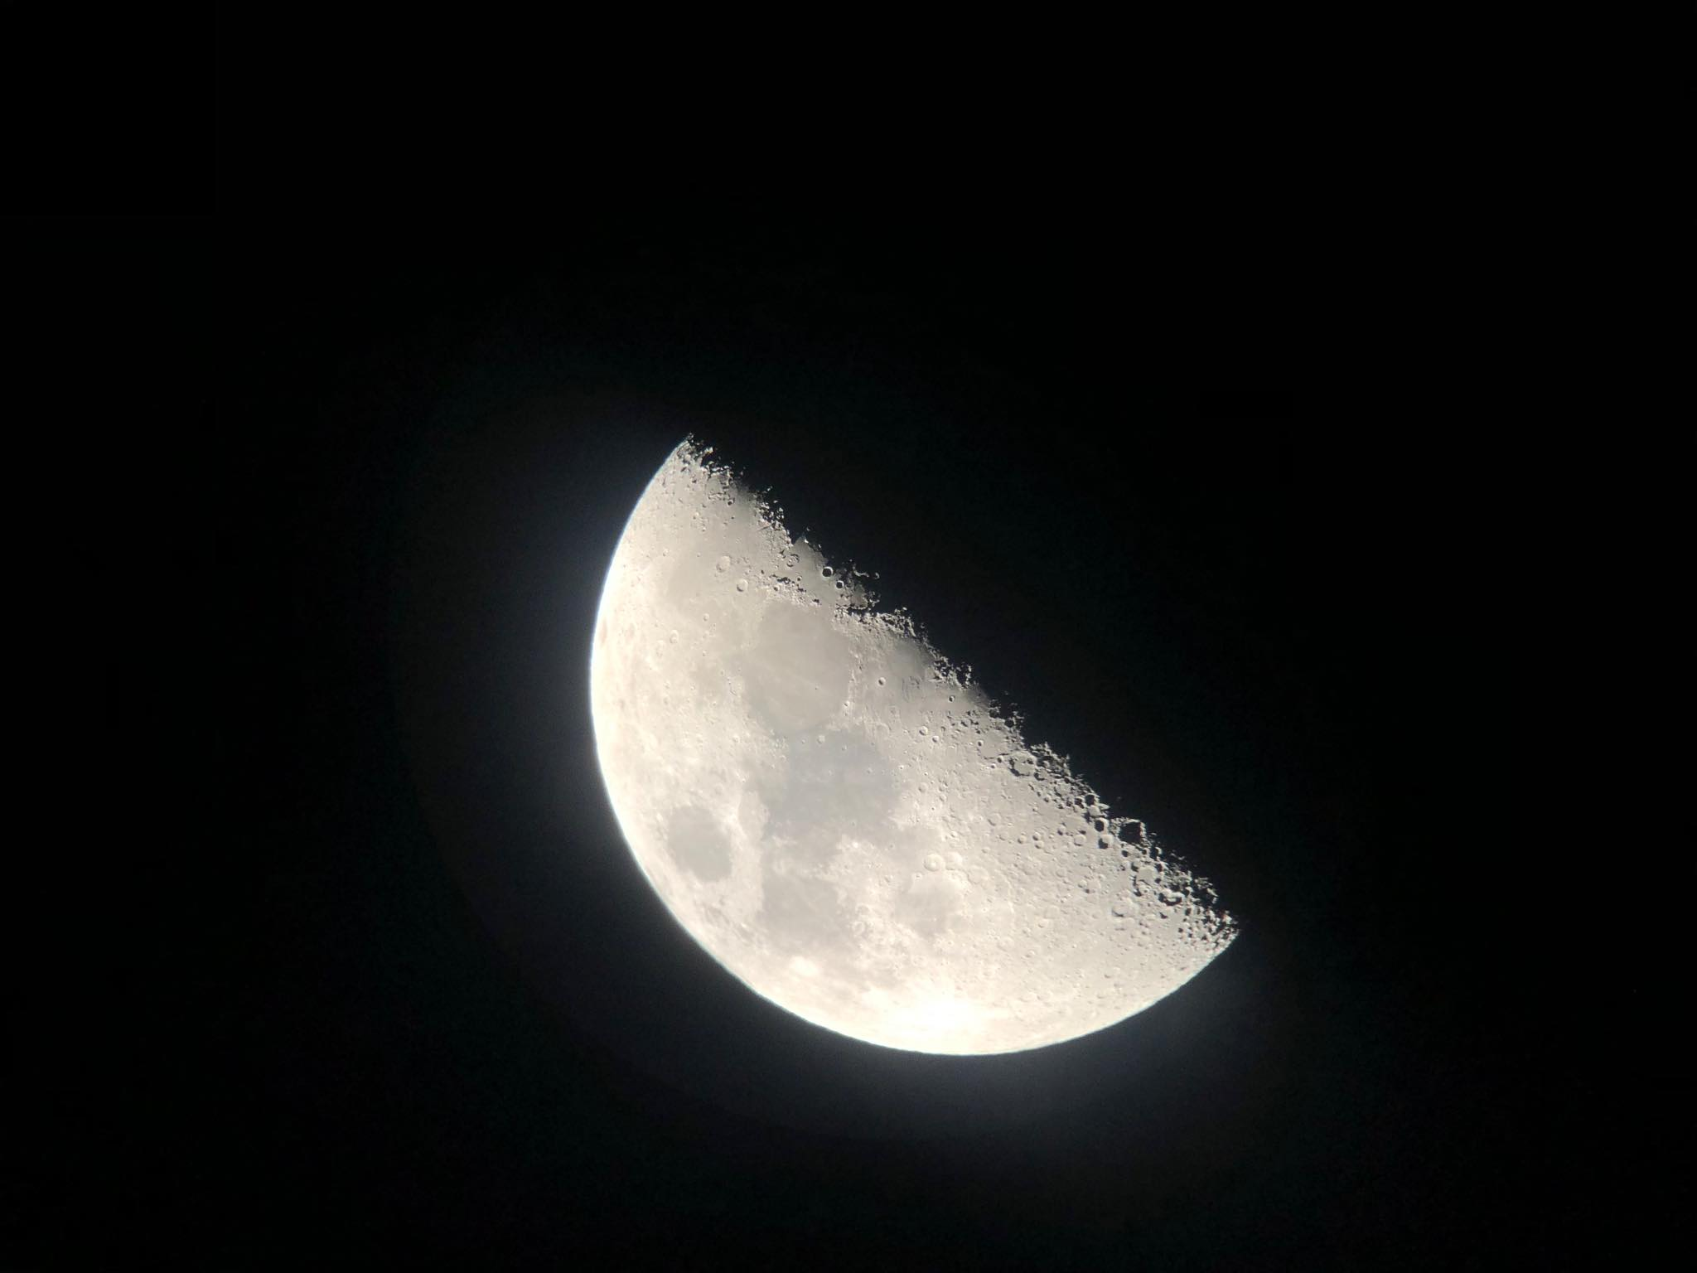
Introduction Tidal deformation
○○○●○
In a binary system of neutron stars, one is subjected to strong tidal effect caused by the other, similar to that between our Earth and the Moon

Slide 7
Objectives
○○○○●
Inclusion of the spin polarization effects of baryons under strong magnetic field (like in a magnetar) into the Equation of States (EoS) of nuclear matter.
Deducing the relation between Neutron Star’s mass and radius corresponding to each EoS model.
Investigating several types of tidal parameters of a Neutron Star in a binary system and their sensitivity to the EoS.

Slide 8

Calculation methods β-stable nuclear matter
●○○○○○○
The Neutron Star matter is assumed to consist of neutron ($n$), proton ($p$), electron ($e$) and muon ($μ$)
$$n↔p+e^{−}+{\overline{ν}}_{e}$$
$$e^{−}↔μ^{−}+ν_{e}+{\overline{ν}}_{μ}$$
β-stable conditions must be fulfilled
Charge balance
$$n_{p}=n_{e}+n_{μ}$$
(1)
Energy balance
$$μ_{n}−μ_{p}=μ_{e}=μ_{μ}$$
(2)

Slide 9

Calculation methods β-stable nuclear matter
○●○○○○○
1. Baryonic components: neutrons ($n$) and protons ($p$)
Total energy of system of nucleons
$$E_{HF}=\sum_{kστ}{\frac{ℏ^{2}k^{2}}{2m_{τ}}}+\frac{1}{2}\sum_{kστ}{\sum_{k’σ’τ’}{\left[\left\langle kστ,k’σ’τ’ | v^{D} | kστ,k’σ’τ’\right\rangle +\left\langle kστ,k’σ’τ’ | v^{EX} | k’στ,kσ’τ’\right\rangle \right]}}$$
(3)
Potential energy
Kinetic energy
Baryonic pressure
$$P_{b}=n_{b}^{2}\frac{∂(E_{HF}/A)}{∂n_{b}}$$
(4)

Slide 10


Calculation methods β-stable nuclear matter
○○●○○○○
1. Baryonic components: neutrons ($n$) and protons ($p$)
CDM3Yn interactions have the form
$$v^{D(EX)}(n_{b}, r)=F_{00}(n_{b})v_{00}^{D(EX)}(r) + F_{01}(n_{b})v_{01}^{D(EX)}(r){(σ}_{1}∙σ_{2})$$
$$+F_{10}(n_{b})v_{10}^{D(EX)}(r){(τ}_{1}∙τ_{2})+F_{11}(n_{b})v_{11}^{D(EX)}(r){(σ}_{1}∙σ_{2})(τ_{1}∙τ_{2})$$
(5)
The central terms are inherited from M3Y-Paris interaction
known
$$v_{στ}^{D(EX)}(r)=\sum_{k=1}^{3}{Y_{στ}^{D(EX)}(k)\frac{e^{−μ_{k}r}}{μ_{k}r}}$$
The density-dependent form factors are
$$F_{στ}(n_{b})=C_{στ}[1+α_{στ}e^{−β_{στ}n_{b}}+γ_{στ}n_{b}]$$
to be adjusted

Slide 11


Calculation methods β-stable nuclear matter
○○○●○○○
2. Lepton components: electrons ($e$) and muons ($μ$)
Consider both of them as relativistic Fermi gases, their pressures and energy densites are
$$P_{l}=\frac{1}{3}\frac{2}{{\left(2π\right)}^{3}}\int_{0}^{k_{F}^{l}}{\frac{ℏ^{2}c^{2}k^{2}}{\sqrt{ℏ^{2}c^{2}k^{2}+m_{l}^{2}c^{4}}} d^{3}k}$$
$$ε_{l}=\frac{2}{{\left(2π\right)}^{3}}\int_{0}^{k_{F}^{l}}{\sqrt{ℏ^{2}c^{2}k^{2}+m_{l}^{2}c^{4}} d^{3}k}$$
(6)
$P(n_{b},Δ)$, $ε(n_{b},Δ)$

Slide 12

Calculation methods Neutron Star’s magnetic properties
○○○○●○○
someword
In a highly magnetized Neutron star (a magnetar), the polarization $∆$ is expected to be
high at lower density
reduce to zero at high density
Figure 1: Different scenarios of $Δ(n_{b})$ considered.

Slide 13

Calculation methods Tolman-Oppenheimer-Volkoff equation
○○○○○●○
The macroscopic properties of neutron star are determined from the equation of states using the TOV equation
$$\frac{dP}{dr}=−\frac{Gρℳ}{r^{2}}\left(1+\frac{P}{ρc^{2}}\right)\left(1+\frac{4πPr^{3}}{c^{2}ℳ}\right){\left(1−\frac{2Gℳ}{c^{2}r}\right)}^{−1}$$
(7)
Mass-Radius M(R)

Slide 14
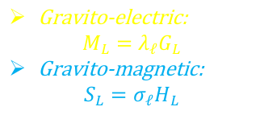
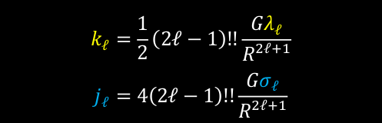
Calculation methods Tidal Love numbers
○○○○○○●
The tidal defomabilities of a neutron star in order $ℓ$ are expressed as
Tidal field strength
Gravito-electric:
$$M_{L}=λ_{ℓ}G_{L}$$
Gravito-magnetic:
$$S_{L}=σ_{ℓ}H_{L}$$
Body’s reaction
(8)
someword
someword
Equivalently, they can also be described by the tidal Love numbers of order $ℓ$
$$k_{ℓ}=\frac{1}{2}\left(2ℓ−1\right)!!\frac{Gλ_{ℓ}}{R^{2ℓ+1}}$$
$$j_{ℓ}=4\left(2ℓ−1\right)!!\frac{Gσ_{ℓ}}{R^{2ℓ+1}}$$
(9)

Slide 15
Results Equation of States
●○○○○○
Figure 2: EoS of Neutron Star matter corresponding to 4 different nucleon-nucleon interaction models.

Slide 16

Results Mass-Radius relation
○●○○○○
someword
Only models with high values of K (CDM3Y6 and CDM3Y8) at partial polarization ($Δ<1$) are plausible
Figure 3: Mass-Radius relation of Neutron Star corresponding with 4 different models and different scenarios concerning the magnetic distribution in the star’s interior.

Slide 17
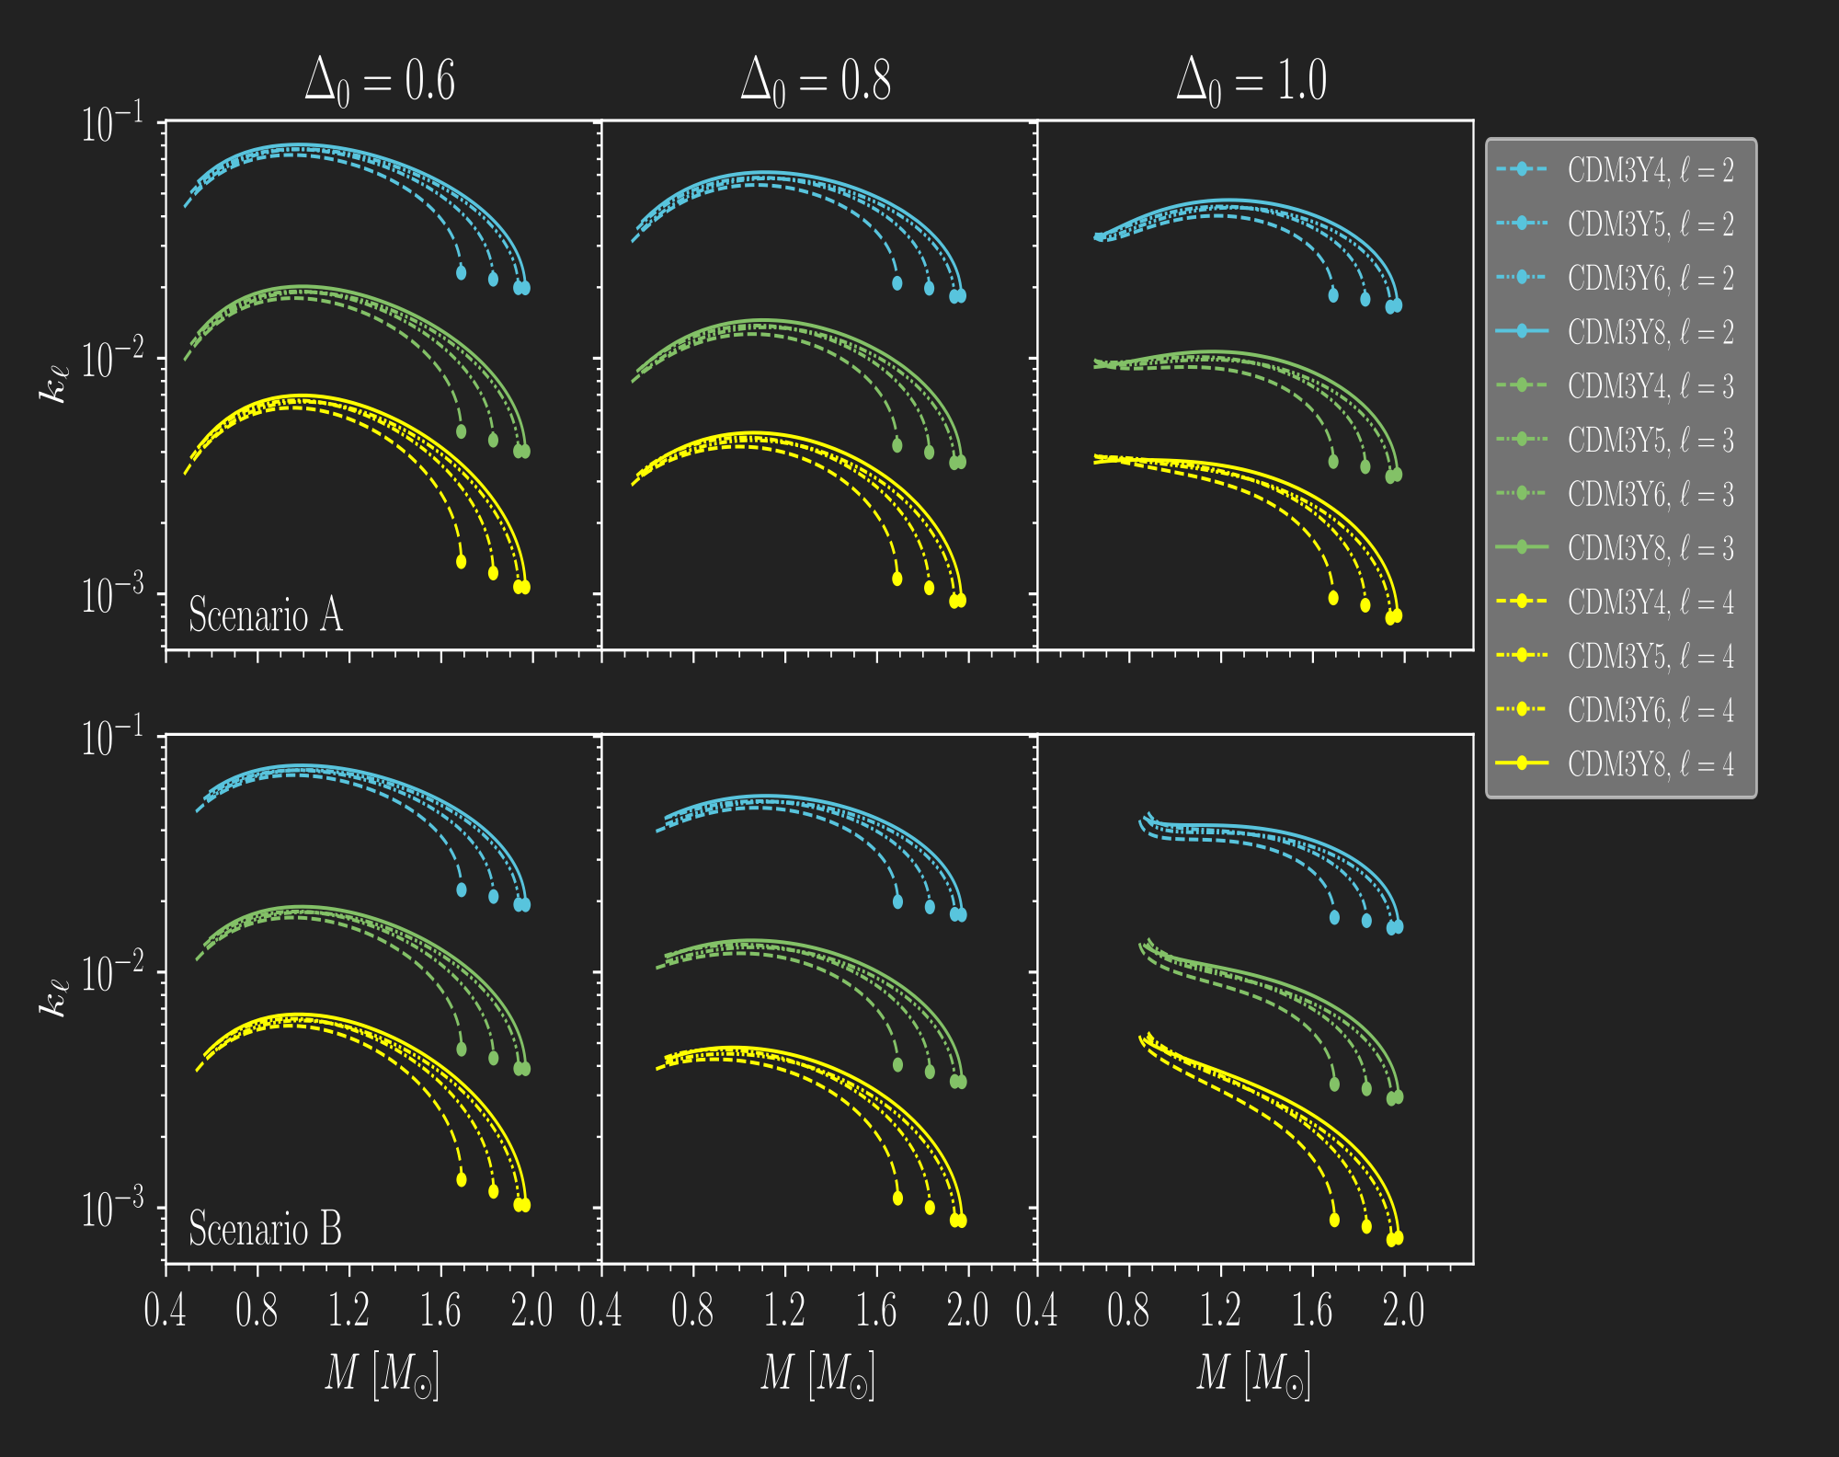
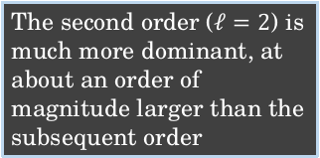
Results Gravito-electric tidal Love numbers
○○●○○○
someword
The second order ($ℓ=2$) is much more dominant, at about an order of magnitude larger than the subsequent order
Figure 4: Gravito-electric tidal Love numbers up to 4th order.

Slide 18

Results Dimensionless tidal parameter
○○○●○○
$$Λ_{2}=\frac{2}{3}k_{2}{\left(\frac{c^{2}R}{GM}\right)}^{5}$$
Figure 5: Gravito-electric dimensionless tidal parameter of 2nd order.

Slide 19
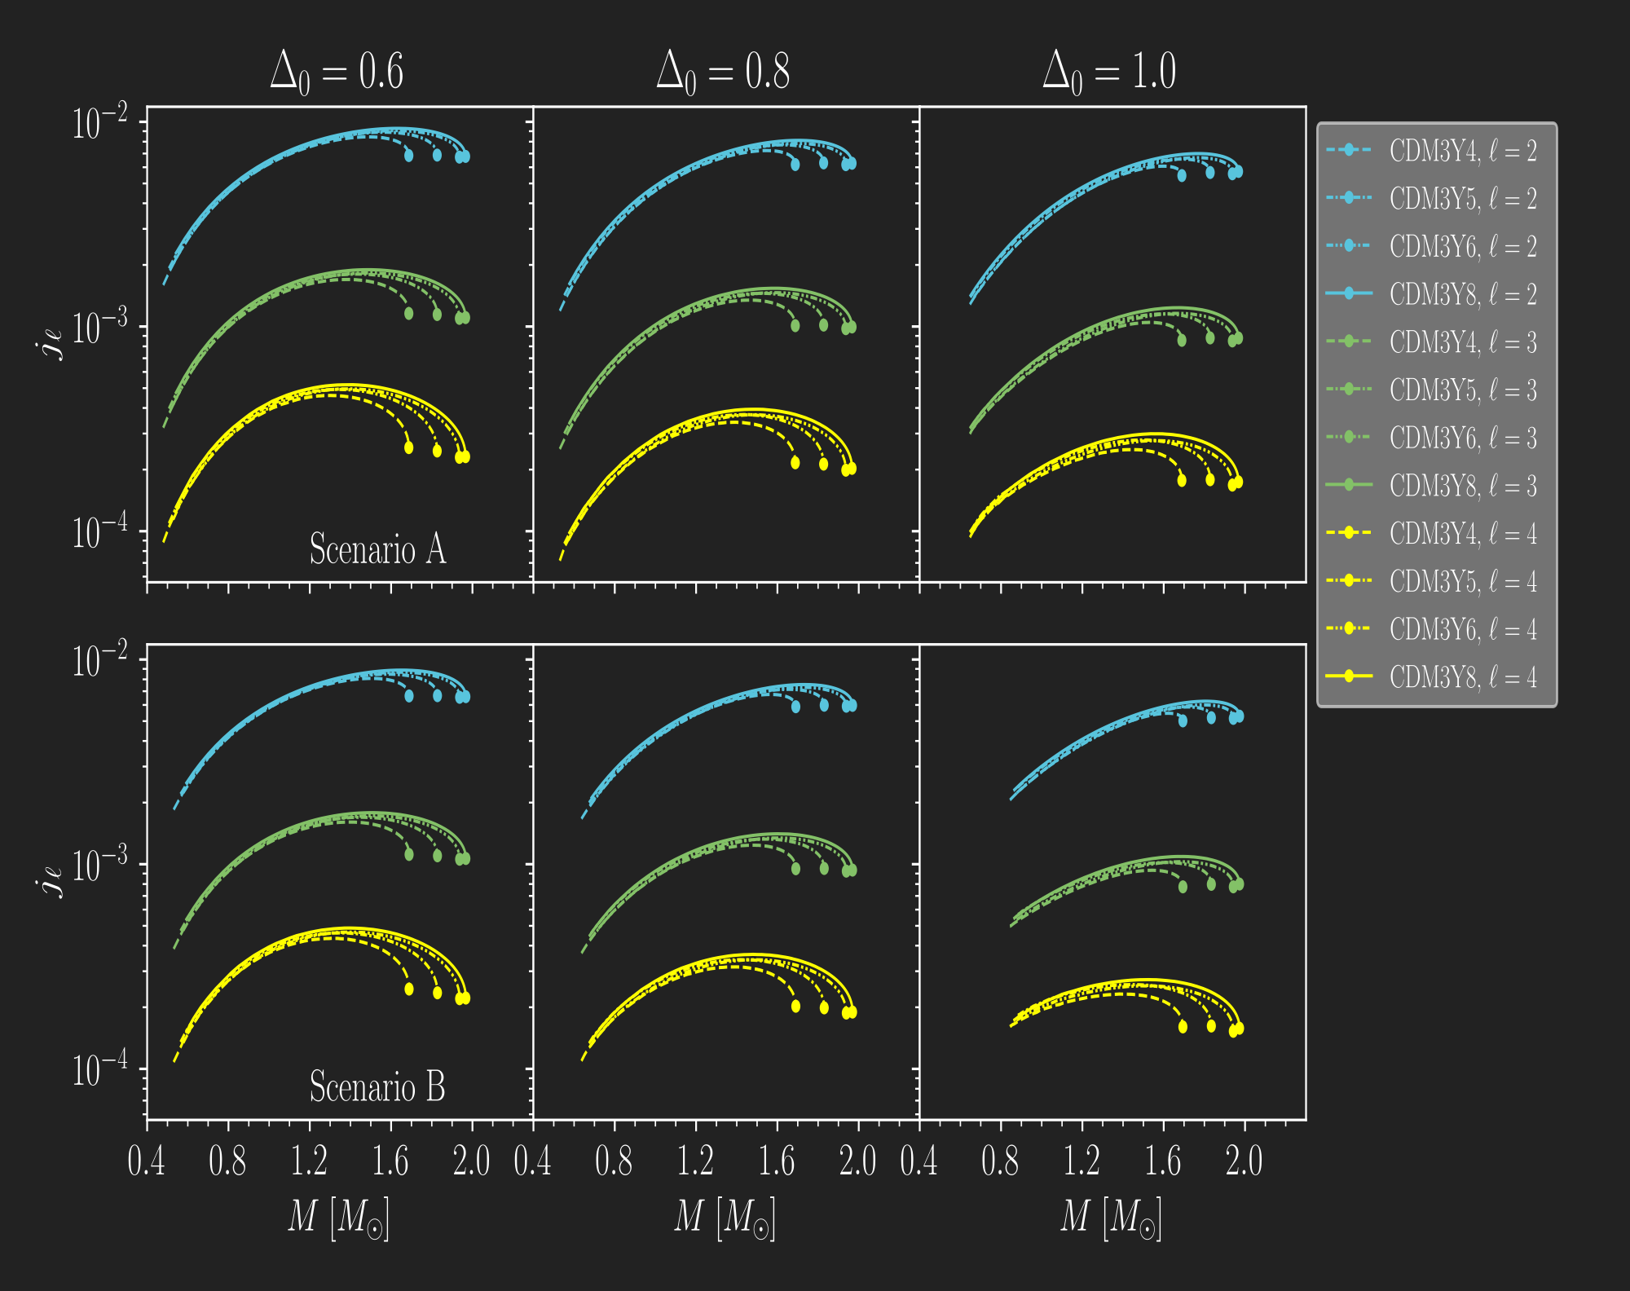
Results Gravito-magnetic tidal Love numbers
○○○○●○
Static fluid
The same trend is found in gravito-magnetic Love numbers. However, they appear to be 1 order of magnitude lower than their GE counterparts.
Figure 6: Gravito-magnetic tidal Love numbers up to 4th order for the case of static fluid.

Slide 20
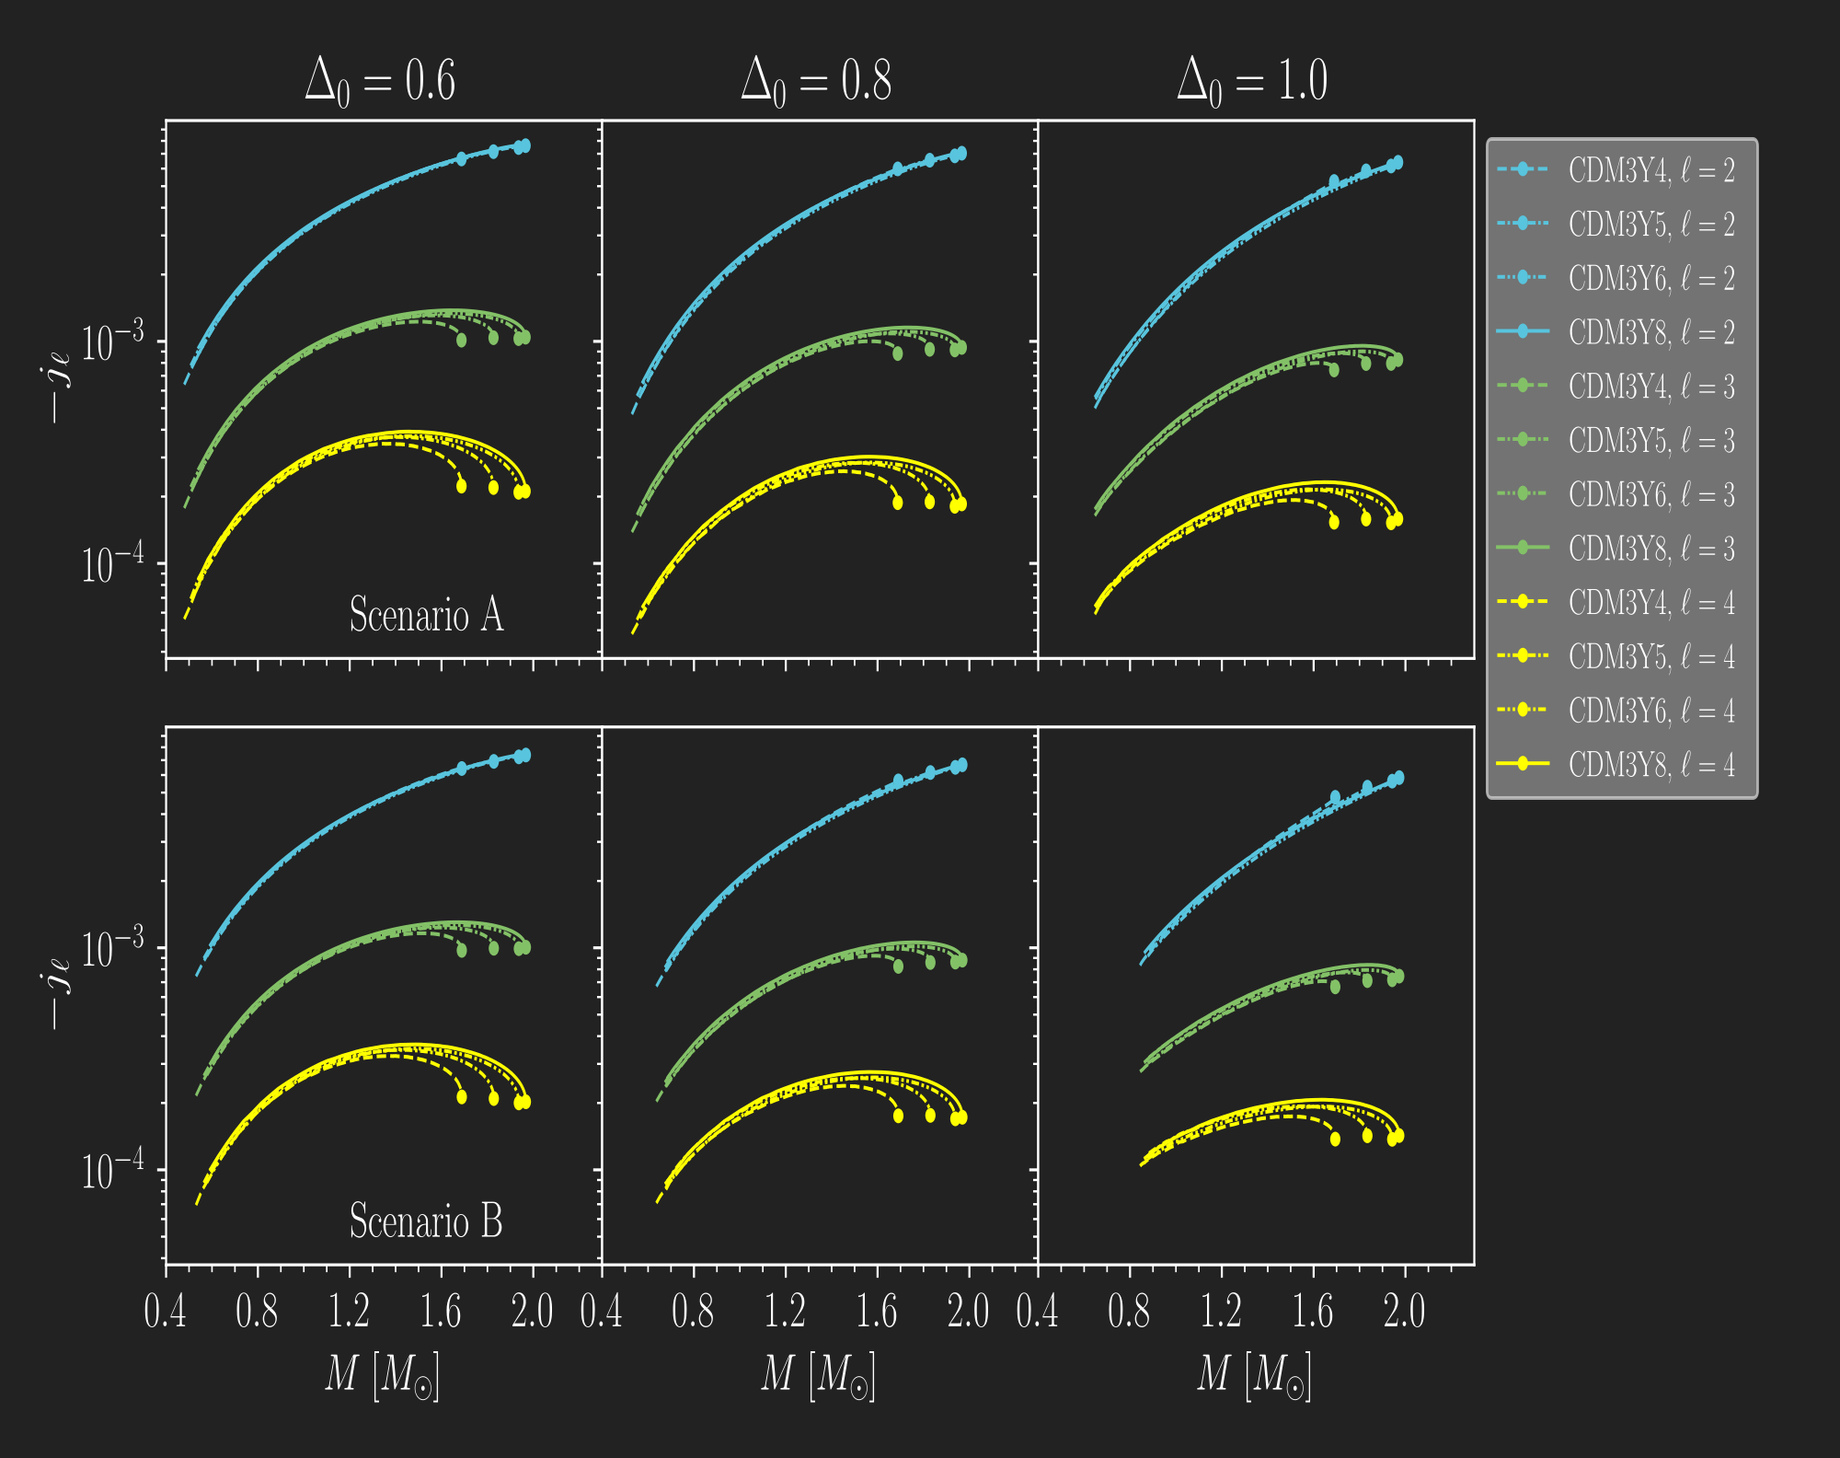
Results Gravito-magnetic tidal Love numbers
○○○○○●
Irrotational fluid
Figure 7: Gravito-magnetic tidal Love numbers up to 4th order for the case of irrotational fluid.

Slide 21
Conclusions
The case of total polarization at the outer core and crust is ruled out as expected.
Higher values of K are favored as only CDM3Y6 and CDM3Y8 come close to the lower mass limit of the heaviest pulsars observed.
The tidal properties of the neutron star are also investigated with different scenarios and up to the fourth order in contribution, which returns a close result with those obtained in recent studies (Perot and Chamel, 2021).

Slide 22

Perspective
Accurately calculate the density-dependence of the polarization $Δ$,
Extending to a model of hot β-stable nuclear matter ($T>0 K$),
Describing the recently found evidence of the quark-matter core in the interior of massive Neutron Stars.
someword

Slide 23
Thank you for your attention!

